Slide 1

Reyki Seprianza
Technical Test data scientist

Slide 2
Experienced in Retail Industry for 6+ years, skilled with Data Analytics, Data Science, Interpersonal Skills, and Presentation. Passionate about learning New Technology, Data Enthusiast, and Artificial Intelligence
About me
https://www.linkedin.com/in/reyki-seprianza/

Slide 3
Some problem with data?
I'd like to bring to your attention an issue regarding the dataset provided for the data engineering task. Upon review, it became apparent that the CSV file contained metadata instead of the expected data. Initially, I mistook it for a GitHub link, assuming I needed to pull the data from there. However, my attempts to retrieve the data were unsuccessful.
Here's an example of the content found within the file:
version https://git-lfs.github.com/spec/v1
oid sha256:72b843d89eb516c9fffa35dd7b36f129fbd80f3f7b26d8fc8a41394e3d9036ff
size 86
It seems that the actual CSV data may be stored using Git Large File Storage (LFS) within a Git repository. I believe further clarification or assistance may be necessary to access the dataset as intended.
Issue Solved by re-send the correct CSV.

Slide 4
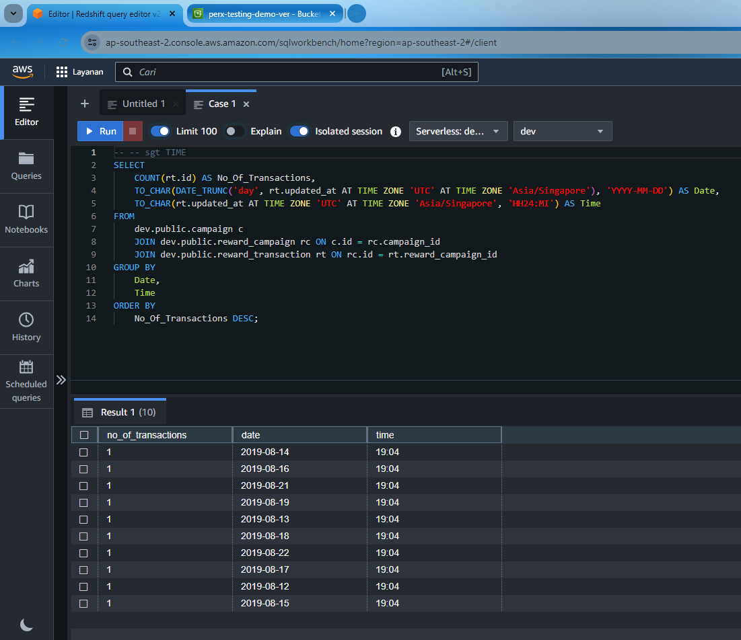
Perx Data Interview-1 :: Data Engineer (SQL Test)
1. Prerequisite:
* Redshift (https://aws.amazon.com/redshift/free-trial/)
* Required CSV files are in folder `./data`, import into Redshift in three diffrent tables as mentioned below. (Redshift's free trial should be enough for this exercise)
Use Case 1:
Client X would like to identify the most popular engagement day and time between a specific date range (Database stored data is in UTC format and input will be in SGT) for a Campaign.
Expected Output:
No Of Transaction | Date | Time

Slide 5
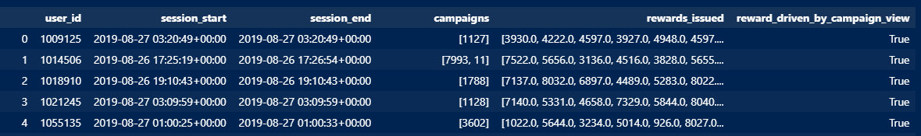
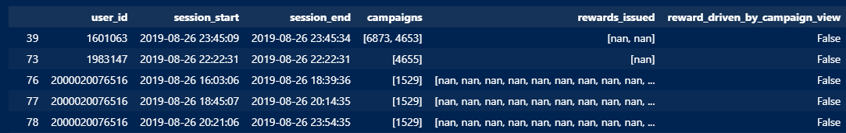
Perx Data Interview-1 :: Data Engineer(Analyse HTTP Log for User Sessions)
Need to provide a report that has
following fields:
* user_id
* session_start (timestamp)
* session_end (timestamp)
* campaigns: list of campaigns the user view
* rewards_issued: list of rewards the user got issued
* reward_driven_by_campaign_view: true if user got a reward issued after viewing a campaign that contains the reward within the session
*Nan value because in the mapping there are not match

Slide 6
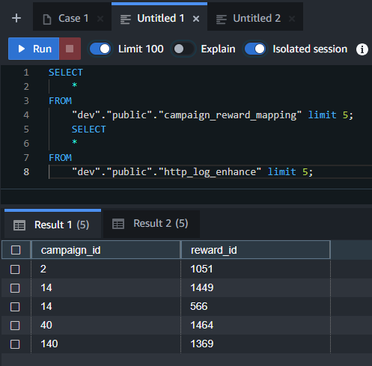
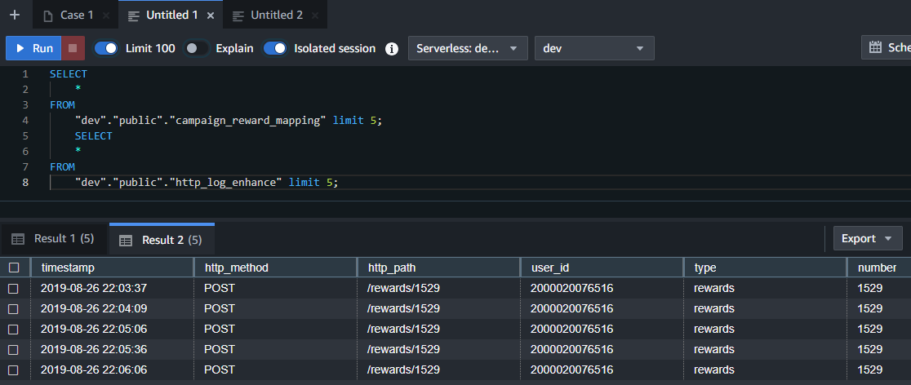
Perx Data Interview-1 :: Data Engineer(Analyse HTTP Log for User Sessions)

Slide 7
Perx Data Interview-2 :: Data Analysts/ Data Scientist
Data Analysis and visualization Task
Use Case
Client X would like to see the BI Dashboard to analyses user engagement and Rewards insights.
Specification
Create a BI Dashboard to analyse User engagement and Reward insights
Data Provided
Please use the file /data/interview_test_voucher_Data.csv that has reward detailed and the associated voucher details. Its also has user details who received voucher.
Deliverable
A working BI Dashboard that show User engagement Insights and reward performance/engagements.

Slide 8
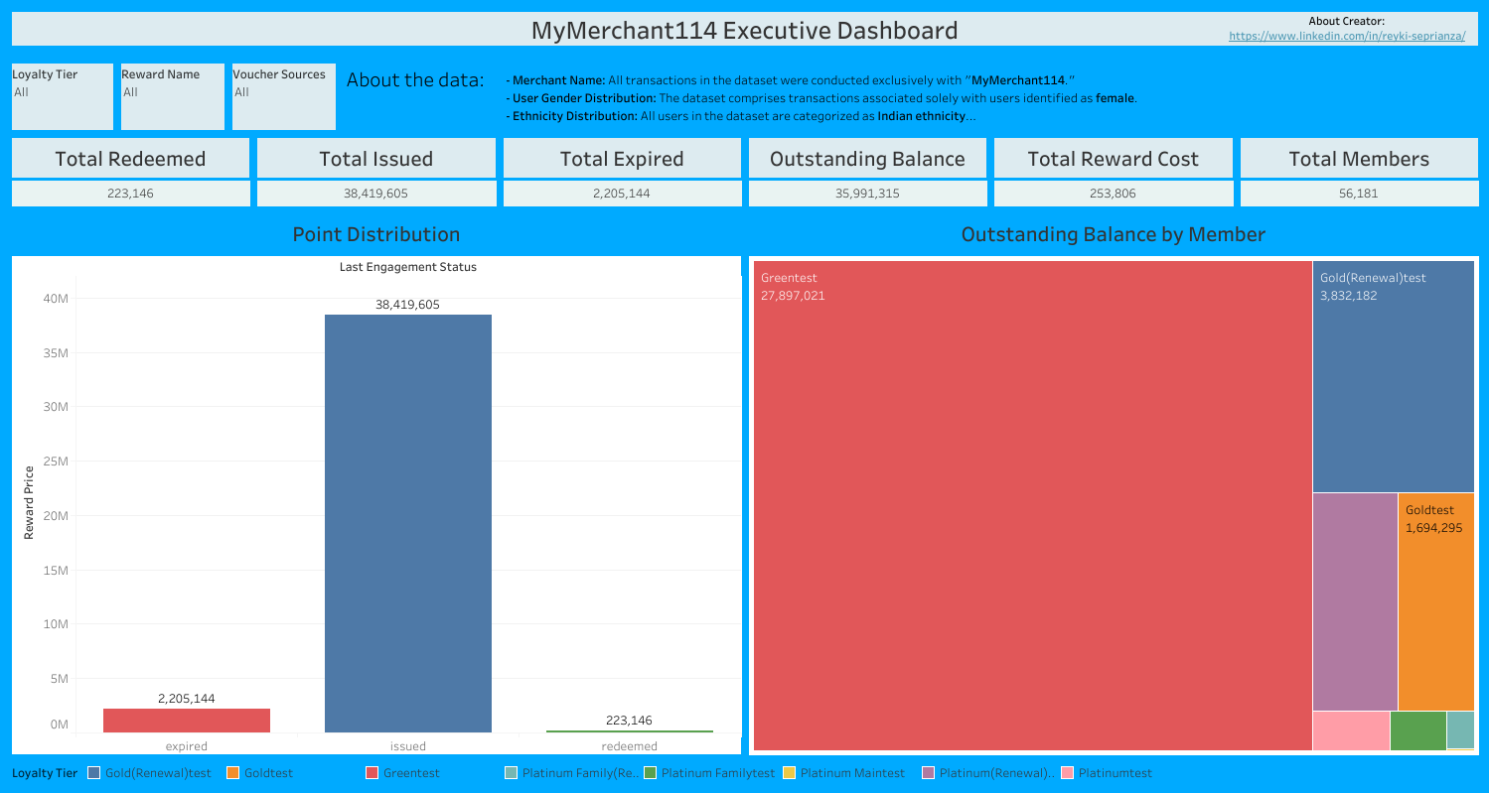
Data Analysis and visualization Task Tableau Public Deployment
Feature:
You can filter data base on
- Loyalty tier
- Reward Name
- Voucher Source
2. There are some Card of important numbers
3. Outstanding balance (new metrics) formula is
issued – redeemed - expired
4. Graph
- Point Distribution
- Outstanding Balance by member tier
Link for dashboard:
https://public.tableau.com/views/MyMerchantVoucherDashboard/MyMerchant114ExecutiveDashboard?:language=en-US&:sid=&:display_count=n&:origin=viz_share_link

Slide 9
Perx Data Interview-2 :: Data Analysts/ Data Scientist
Machine Learning for Recommendation Task
Use Case
Client X would like to understand its customers behaviour to recommend relevant rewards for future campaigns.
Specification
Create a working machine learning (unsupervised model) solution that recommend rewards when input a user_id.
You are free to use any Python framework including tensorflow, Keras, scikit-learn and pytorch.
Data Provided
Please use the public [movielens 1M dataset](https://grouplens.org/datasets/movielens/1m)

Slide 10
Machine Learning for Recommendation Task
I’ve made Model and some traditional methods below
1. Recommendation for a specific user: This model provides personalized recommendations based on the user's past ratings and preferences.
2. Recommendation for a not-logged-in user: This model provides recommendations without relying on a specific user's history, often using general popularity or genre preferences.
3. Recommendation for users in a specific area: This model tailors recommendations based on the location (zip code) of the user, possibly reflecting regional preferences or trends.

Slide 11
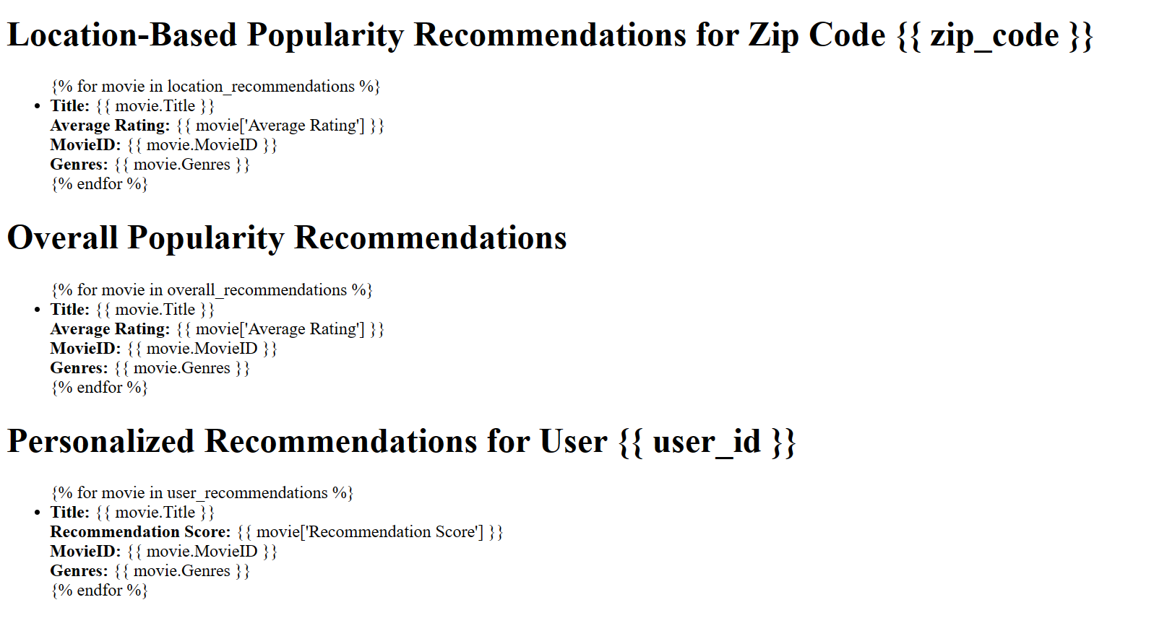
Deployment : Index File

Slide 12
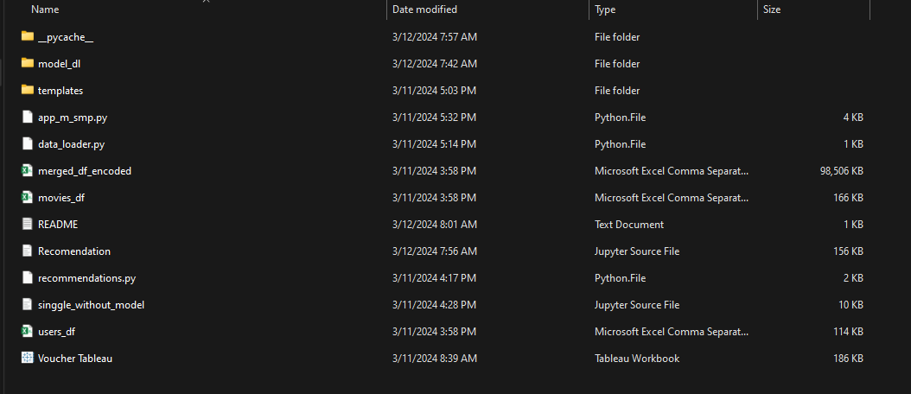
How to run the file
how to run recommendation engine app:
open your cmd on this location and type
python .\app_m_smp.py
this action will trigger flask app to run and open http://127.0.0.1:5000 on your browser
NOTE:
i'm hard code zipcode into '1234' and user id '8', feel free to change it on file "app_m_smp.py"

Slide 13
Deployment Structure
There are 5 file in my task
1. app_m_smp.py -> main logic
2. data_loader.py -> to load model and df
3. recommendations.py -> to storage some functions
4. Folder of HTML file to run index
5. Tensorflow model named “model_dl”

Slide 14
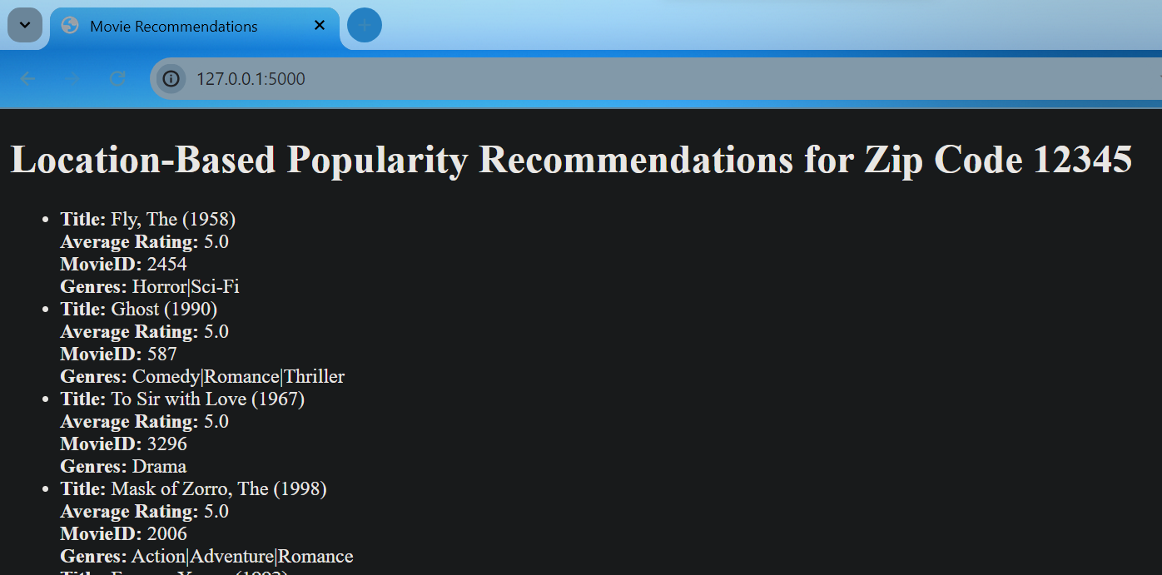
Result Deployment

Slide 15
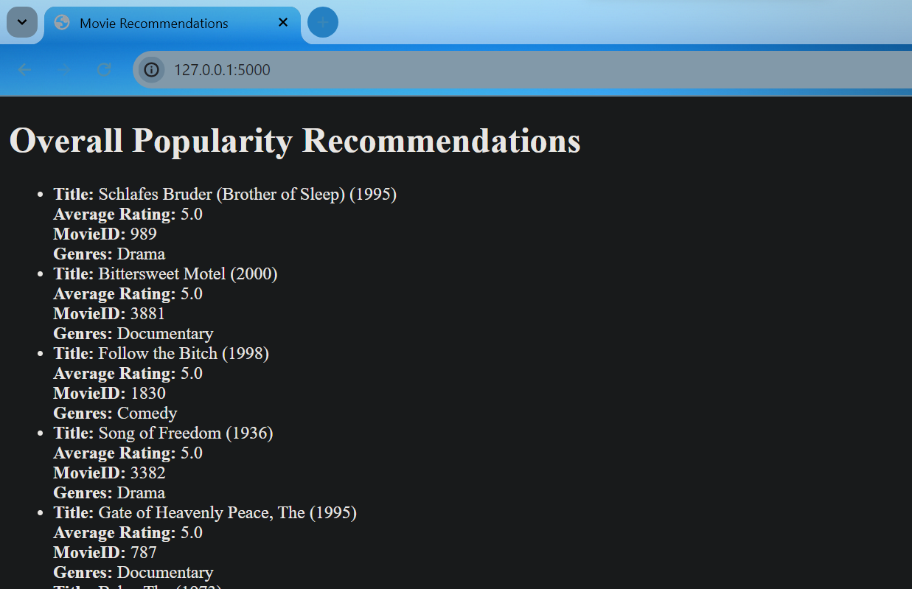
Result Deployment

Slide 16
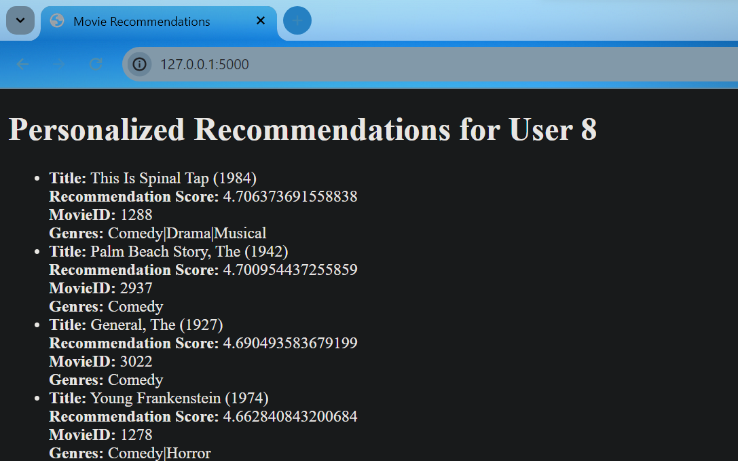
Result Deployment

